Slide 1
START ASF4架构的SPI初始化流程
2018.5.11

Slide 2

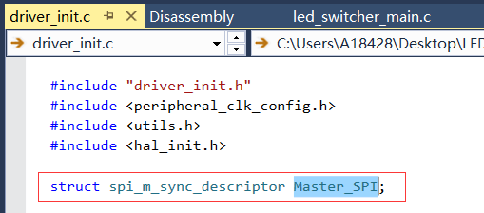
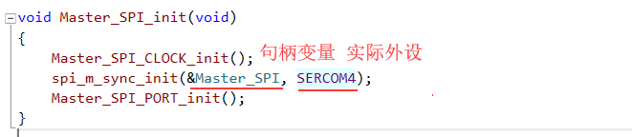
SPI初始化流程
1.定义句柄变量，用于建立HAL层与实际硬件外设的链接。
2.驱动初始化
第一步：
定义句柄变量
第二部
硬件初始化
Notes:
Driver handle
As part of the abstraction between a specific hardware implementation and the HAL interface, the HAL driver specifies its own handle to store necessary data like hardware register interface pointers, buffer pointers, etc. The handle is used as a parameter to HAL functions in order to identify which resource to address
The handles have the following definition: struct [namespace]_descriptor Example: struct usart_sync_descriptor USART0;
Driver initialization All HAL interfaces have an initialization function named init(). This function is responsible for loading the module configuration, pin MUX setup, and clock source setup found in the configuration file. This function is also responsible for initializing the HAL device handle, with references to the hardware interface and buffers if needed. The parameter list of this function shall start with the HAL device handle, followed by a pointer to the hardware register interface of the module instance to be associated with this HAL device. Any parameters after the first two parameters are interface specific. After this call the module is enabled and ready for use, if not an error code should be returned to the application.
Name convention [namespace]_init(struct [namespace]_descriptor *desc, adc *hw, ...); Example adc_sync_init(struct adc_sync_descriptor *adc, adc *hw, ...);
Driver deinitialization All high level HAL interfaces have a deinitialization function named deinit(). This function is responsible for releasing the hardware module and any resource allocated by this module. This includes disabling any clock source to the module, resetting any pin MUX setting and resetting the module itself.
Name convention [namespace]_deinit(struct [namespace)_descriptor *desc); Example adc_sync_deinit(struct adc_sync_descriptor *adc);

Slide 3
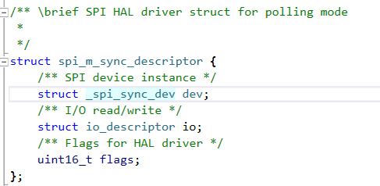
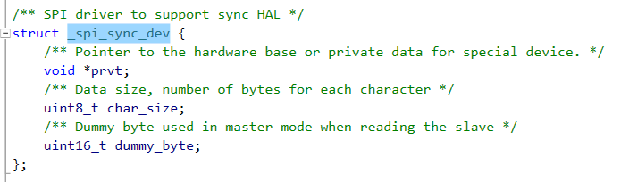
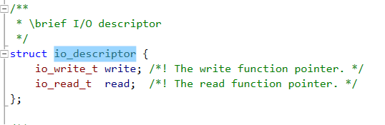
SPI句柄变量分析

Slide 4
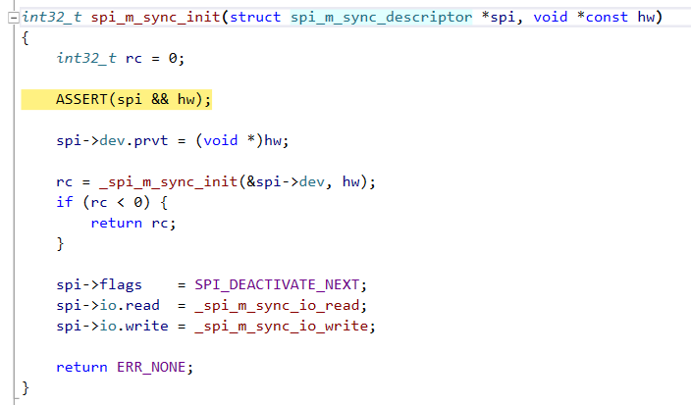
SPI初始化流程分析
SPI层的设备指针指向具体的硬件设备地址

Slide 5
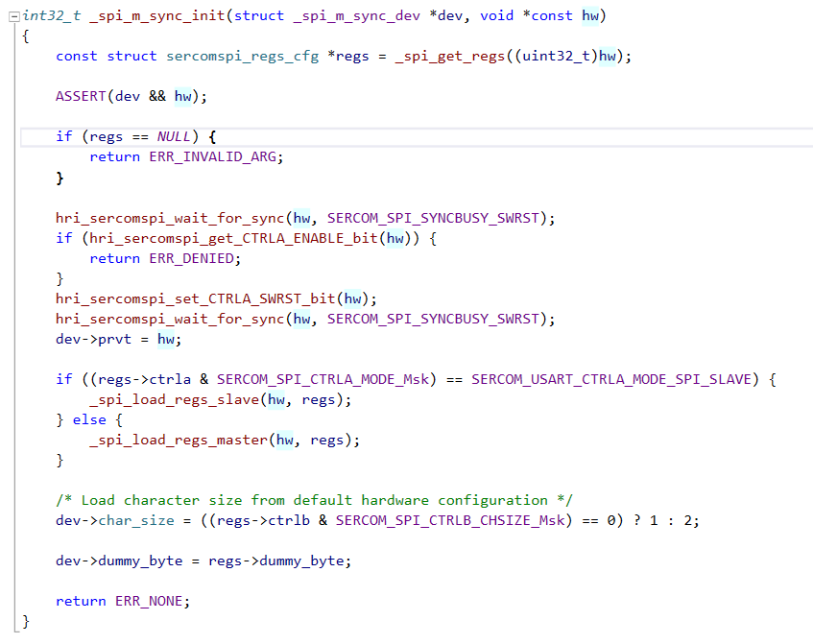
SPI初始化流程分析
请留意regs 是通过_spi_get_regs()这个函数获取SPI的硬件参数配置值的。
设置SPI 相关寄存器的参数值
param[in, out] hw
Pointer to the hardware register base.
param[in] regs
Pointer to register configuration values

Slide 6
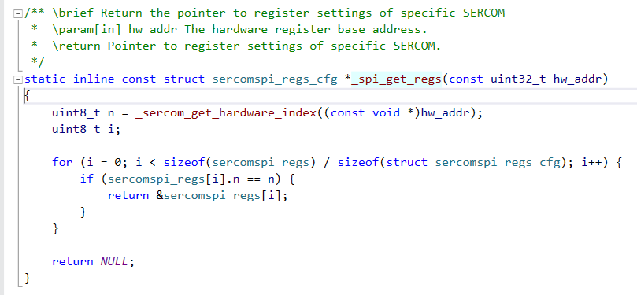
SPI初始化流程分析 – 如何传递SPI的配置参数
在这个例子中，传递下来的是SERCOM4

Slide 7
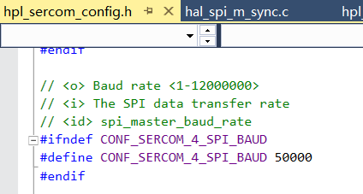
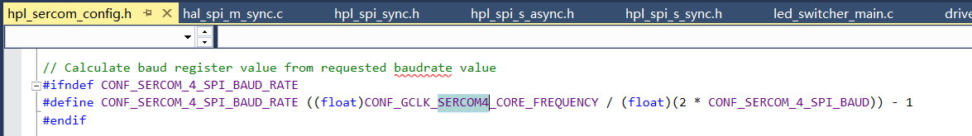
SPI初始化 – baut rate 配置文件更改

